Slide 1
Mechanical - Locomotive Tom Lambrecht

Slide 2
Mechanical – philosophy / guiding principles
Keep it Simple
Tried and proven technology
Standardization, Parts Interchangeability, Inventory Management
Enhanced reliability of CP Equipment
Competitive Supply Base
Move away from long term service agreements
Price is only one component: Quality, Delivery, Capability, Warranty
Partnerships in product development and compatibility
Leverage Technology – Constructive vs. Disruptive
Data to drive better decisions
A safer, more efficient railroad
Provide Service Cost Control Asset Utilization Safety Develop People

Slide 3
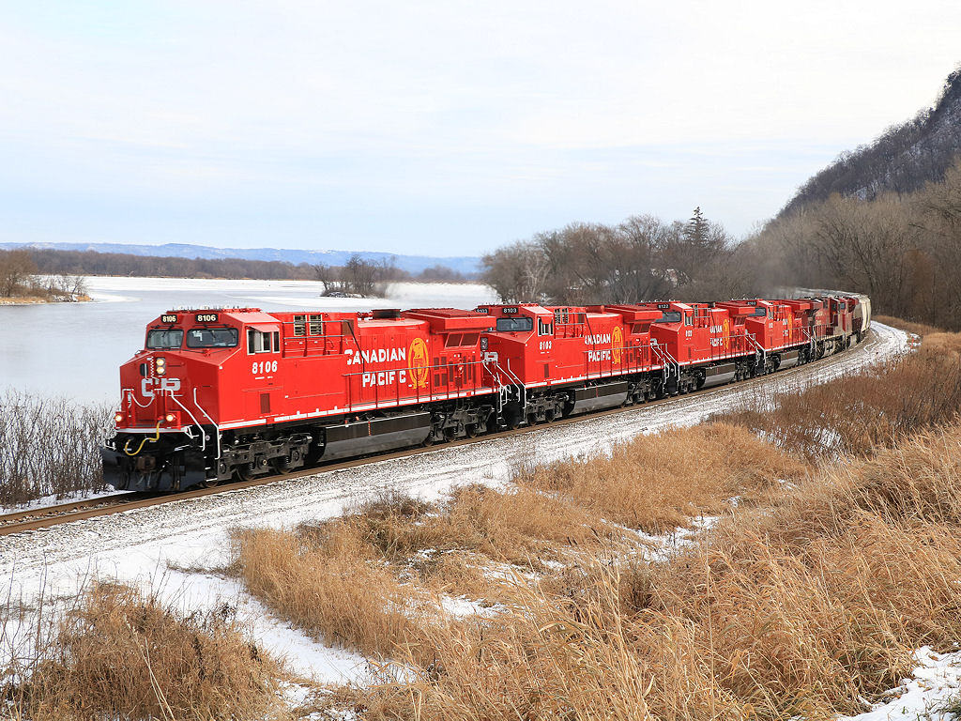
Investing in the future – Locomotive initiatives
Modernization of Legacy Equipment
Capital Efficient
Proven Technology “Design for Reliability”
Restructure Maintenance Contracts
250 AC4400 “CP Maintenance” - 2019
Trucks & Truck Components – Now
Technology
Reliability
Fuel Savings
Provide Service Cost Control Asset Utilization Safety Develop People

Slide 4
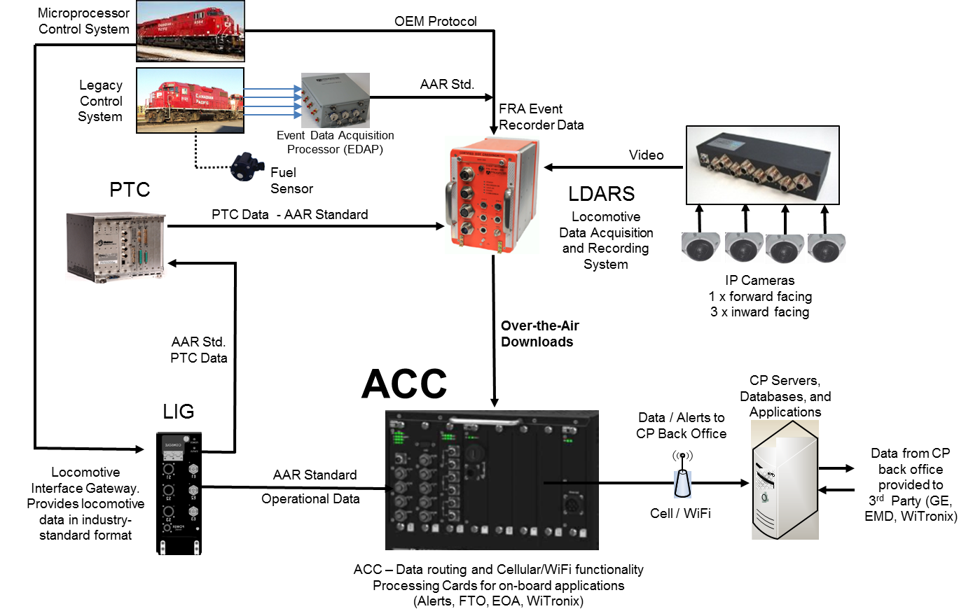
Locomotive technology
Standardized Electrics Architecture:
Open Standard Architecture, non-proprietary
Host CP, OEM and 3rd party apps
Auxiliary Card Cage (ACC):
Bring your Ethernet network device
Software hosted on ACC HPAP Card
ACC = “iPhone”
Build an App for that!!!
Provide Service Cost Control Asset Utilization Safety Develop People

Slide 5
2018 Capital Program – objectives & opportunities Justin meyer, vp engineering Planning

Slide 6
Our foundations
Driving change and improvement
Our Capital Plan and all Engineering activities must support our 5 Foundations
1

Slide 7
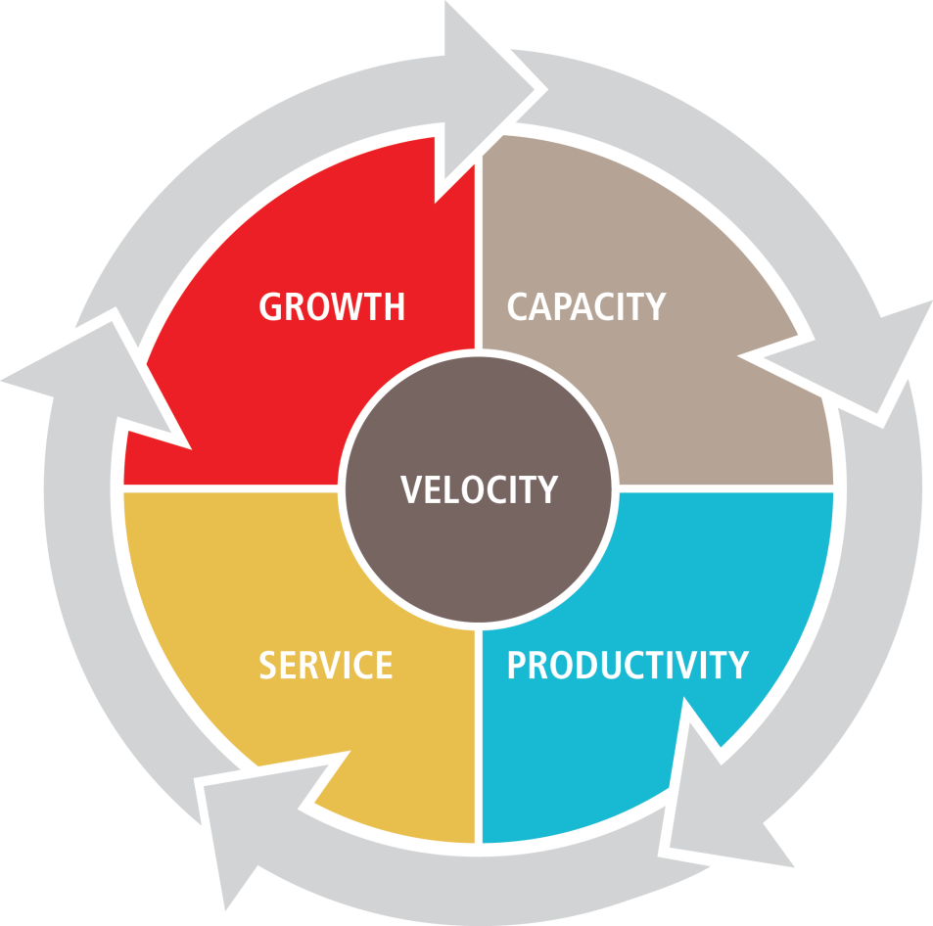
Taking it to the next level
Reinvesting in the network
Improving throughput and capacity
Continued productivity gains lower our cost structure
Better service offering
Accelerated growth
3

Slide 8
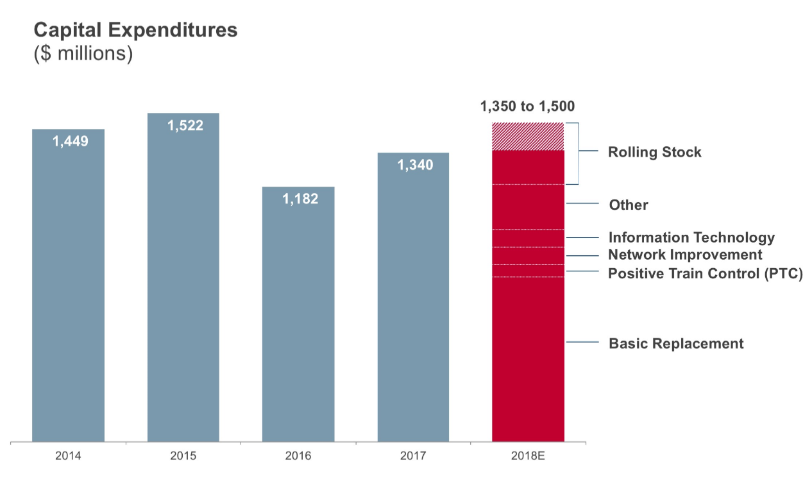
Engineering – Size up
Basic Replacement Historic Capital
2018 Engineering Capital Range ~$720 million (CDN)
Basic replacement capital
4

Slide 9
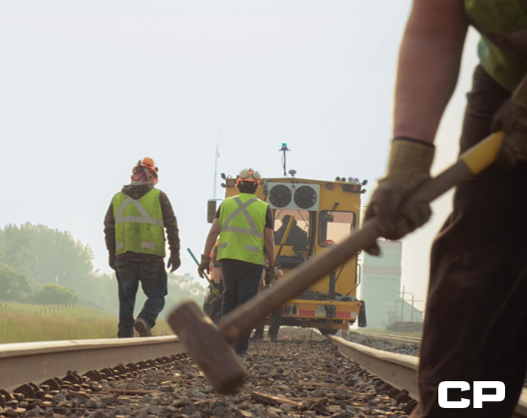
Engineering track Programs – 2018
196 miles of new rail
92 miles of relay rail
1,170,000 cross ties
71 miles of out of face and spot ballast renewal (BC & North Line)
79 turnouts (skewed to our Western corridor)
Target 23,000 joints eliminated (continued intensified focus)
All numbers approximate
5

Slide 10
Significant non-capital activities
Controlling cost - driving safety & reliability
Rail Grinding – New production grinder started on the system this week
Rail Flaw Detection – Increased testing to reduce service outages and ensure operating plan compliance for our customers.
Geometry testing including autonomous testing.
9

Slide 11
Success from partnerships
Work in partnership with labor organizations, service providers and material suppliers to achieve our goals.
Understanding of the environment we operate in (short work windows, high urgency).
Self-reliance and independence in execution of work.
Innovative and focused on identifying efficiencies.
Strict adherence to safety requirements, leaders in safety.
10

Slide 12
CP Strategic Procurement & Supply (SP&S) Chad Rolstad

Slide 13
Our foundations

Slide 14
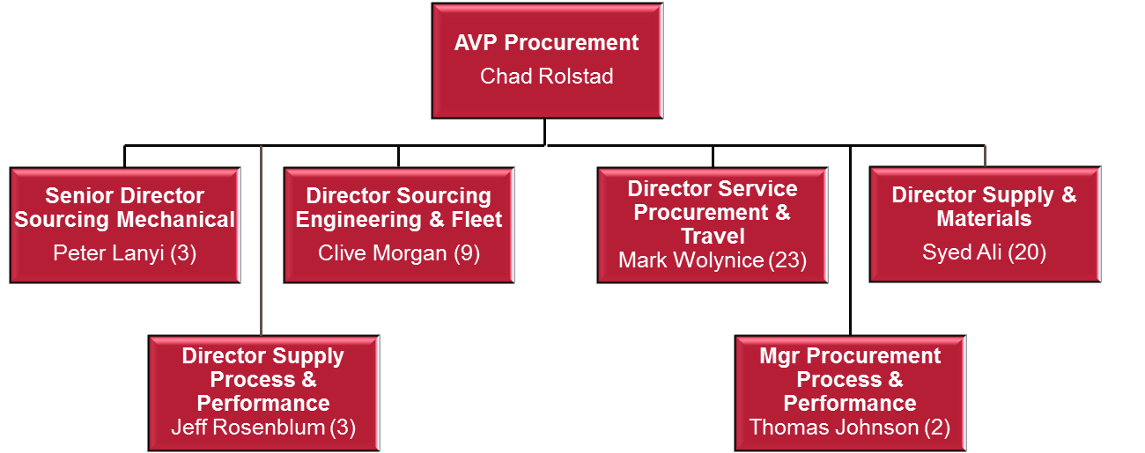
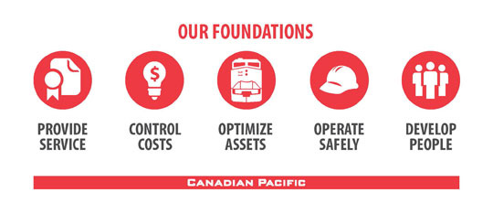
Strategic procurement & supply (SP&S) vision
Vision: Strategic Procurement & Supply will optimize supply chain processes to deliver safe & reliable goods and services that maximize value to CP. SP&S commits to support and collaborate with our stakeholders in the development of innovative, timely and efficient solutions. We strive to become a leader in delivering transformational ideas that build on the core foundations of CP.
CP Foundations
SP&S Strategic (5-Year) Plan
SP&S Tactical Execution
Slide 2
Notes:
$1.6B spend under “management” – Does not include large programs such as Modernizations, Grain Car build, etc
Roughly 1/3 Material 2/3 Services ($1B in Services)
Vision – Service Provider – First and Foremost, but we are also strategic business partners.
2 functions of the organization : Supply/Execution and Sourcing/Strategy – We have very few people doing Sourcing/Strategy & most people focused on execution
We must improve our procurement processes & tools, so that we can re-deploy people into sourcing related functions

Slide 15
Key 2018 Objectives
Strategic procurement & Supply
Supply Chain Execution
Establishment & Reporting of KPI’s
Inventory Planning & Rationalization
Locomotive Strategy
Fleet Expansion/Modernization
Maintenance Component Strategy
Scrap Tie & Metal Recovery
Developing New Partnerships
Engineering Services
End to End Process Redesign
Fleet Vehicle Utilization
Technology Implementation

Slide 16
Questions

